Slide 1
Introduction to eQTLs

Slide 2
Learning Objectives
To learn about combining different biological data types for analysis
To learn methods for linking genetic information with gene expression

Slide 3

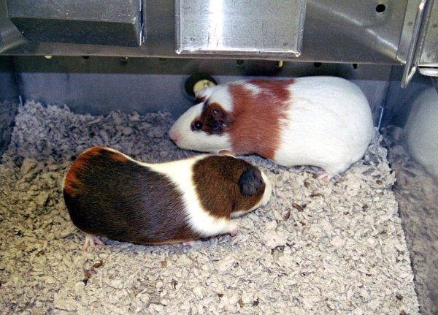
Genotypes and Phenotypes
An individual’s genotype is their heritable genetic information, as encoded in their respective genome
A phenotype is an observable property resulting from that genotype as well as any environmental effects
Jonathan Bailey, Gregg Langham, Courtesy: National Human Genome Research Institute.

Slide 4
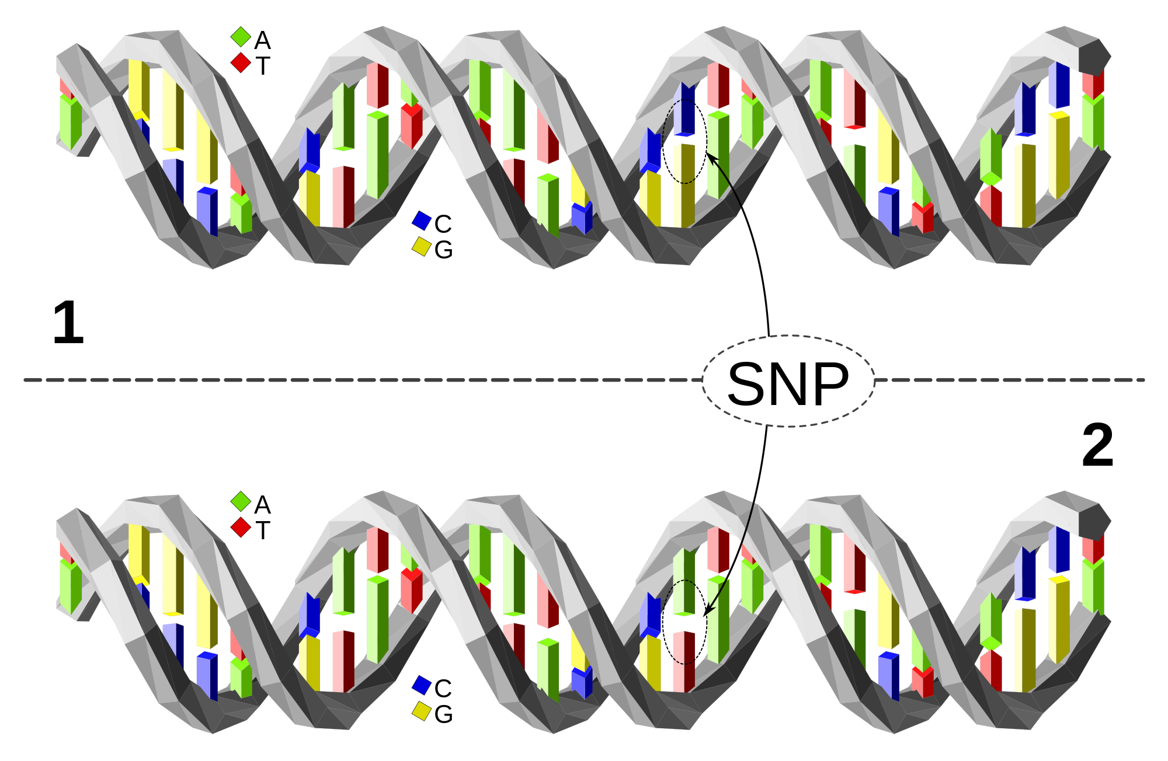
Individual Human Genotypes
When we speak of ‘genotypes’, we are typically referring to the millions of positions within the human genome that have been observed to be different between some individuals.
We refer to these differences as polymorphisms. A Single Nucleotide Polymorphism is denoted as a SNP (<snip>)
Image by David Eccles / CC-BY-4.0

Slide 5
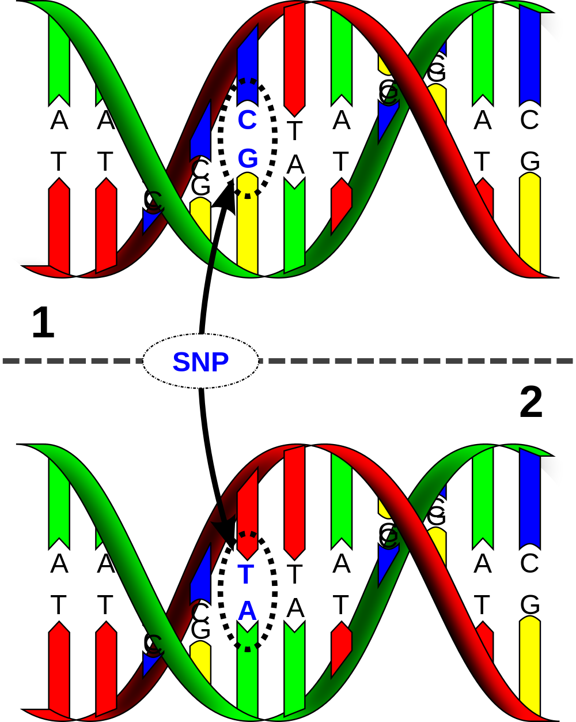
Describing Genotypes
An individual position in the genome, termed a nucleotide or base, can be one of 4 alleles (A,C,T,G).
Diploid organisms such as humans have both maternal and paternal alleles.
Genotypes at these positions are thus described as combinations of these alleles, e.g. C/C, C/G, and G/G.

Slide 6
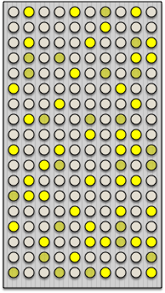
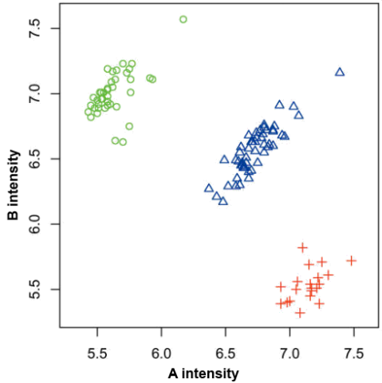
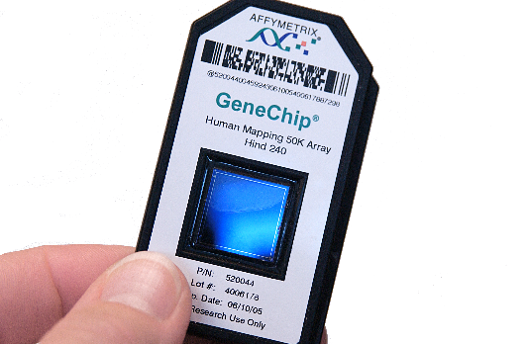
Ascertaining Genotypes
SNP Microarrays
TAACGATGAATCTTAGGCATCGCGC
TAACGATGAATCGTAGGCATCGCGC
genotype: T/T
Shearing
Labeling
GGCTTAAGTACCCTATGGATTACGG
GGCTTAAGTACCTTATGGATTACGG
genotype: C/T
Maggie Bartlett, Courtesy: National Human Genome Research Institute.

Slide 7
Ascertaining Genotypes
Whole Genome/Exome Sequencing
SNP
ATCCTGATTCGGTGAACGTTATCGACGATCCGATCGA
sequencing error or genetic variant?
ATCCTGATTCGGTGAACGTTATCGACGATCCGATCGA
CGGTGAACGTTATCGACGATCCGATCGAACTGTCAGC
GGTGAACGTTATCGACGTTCCGATCGAACTGTCAGCG
TGAACGTTATCGACGTTCCGATCGAACTGTCATCGGC
TGAACGTTATCGACGTTCCGATCGAACTGTCAGCGGC
TGAACGTTATCGACGTTCCGATCGAACTGTCAGCGGC
GTTATCGACGATCCGATCGAACTGTCAGCGGCAAGCT
TTATCGACGATCCGATCGAACTGTCAGCGGCAAGCT
ATCCTGATTCGGTGAACGTTATCGACGATCCGATCGAACTGTCAGCGGCAAGCTGATCGATCGATCGATGCTAGTG
reference genome
TTATCGACGATCCGATCGAACTGTCAGCGGCAAGCT
TCGACGATCCGATCGAACTGTCAGCGGCAAGCTGAT
ATCCGATCGAACTGTCAGCGGCAAGCTGATCG CGAT
TCCGAGCGAACTGTCAGCGGCAAGCTGATCG CGATC
TCCGATCGAACTGTCAGCGGCAAGCTGATCGATCGA
GATCGAACTGTCAGCGGCAAGCTGATCG CGATCGA
sequencing error or genetic variant?
AACTGTCAGCGGCAAGCTGATCG CGATCGATGCTA
TGTCAGCGGCAAGCTGATCGATCGATCGATGCTAG
TCAGCGGCAAGCTGATCGATCGATCGATGCTAGTG
INDEL

Slide 8
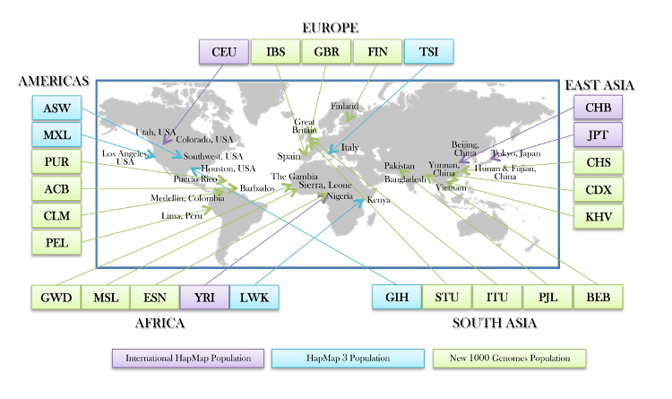
1000 Genomes Project
Generated whole genome sequences for 2504 individuals across 26 global populations, finding over 88 million points of genetic variation.
A typical genome differs from a consensus human genome at 4.09 - 5.02 million sites, affecting ~20 million bases of sequence
www.1000genomes.org

Slide 9
Storing Genotypes
VCF files are used to store genotypes for specific genomic positions across multiple individuals
The consensus (reference) allele is indicated in the REF column, while the alternative allele (s) are indicated in the ALT column.
Alleles are then labeled as 0 (REF) or 1 (ALT) for each site and encoded as genotypes 0|0, 0|1, and 1|1 for different allelic combinations observed in specific samples
#CHROM POS ID REF ALT QUAL FILTER INFO FORMAT NA00001 NA00002 NA00003
20 14370 rs6054257 G A 29 PASS NS=3;DP=14;AF=0.5;DB;H2 GT:GQ:DP:HQ 0|0:48:1:51,51 1|0:48:8:51,51 1/1:43:5:.,.
20 17330 . T A 3 q10 NS=3;DP=11;AF=0.017 GT:GQ:DP:HQ 0|0:49:3:58,50 0|1:3:5:65,3 0/0:41:3
20 1110696 rs6040355 A G,T 67 PASS NS=2;DP=10;AF=0.333,0.667;AA=T;DB GT:GQ:DP:HQ 1|2:21:6:23,27 2|1:2:0:18,2 2/2:35:4
20 1230237 . T . 47 PASS NS=3;DP=13;AA=T GT:GQ:DP:HQ 0|0:54:7:56,60 0|0:48:4:51,51 0/0:61:2
21 1234567 microsat1 GTC G,GTCT 50 PASS NS=3;DP=9;AA=G GT:GQ:DP 0/1:35:4 0/2:17:2 1/1:40:3

Slide 10
VCF File Access
VCF files can be very large and are typically dividing into individual files for each chromosome. Even then, depending on the project each file can contain millions of rows with genotypes for thousands of sample.
VCF files are therefore typically compressed and indexed to reduce their size while still allowing random access. However, a specialized compression algorithm needs to be used in order to do this.
bgzip: modified version of gzip which compresses VCF file
bgzip GEUVADIS.chr1.PH1PH2_465.IMPFRQFILT_BIALLELIC_PH.annotv2.genotypes.vcf
tabix: indexes files compressed with bgzip
tabix -p vcf GEUVADIS.chr1.PH1PH2_465.IMPFRQFILT_BIALLELIC_PH.annotv2.genotypes.vcf.gz
subsets files with coordinate ranges
tabix –h GEUVADIS.chr1.PH1PH2_465.IMPFRQFILT_BIALLELIC_PH.annotv2.genotypes.vcf.gz chr1:5363-5463
Both are part of the HTSlib software package: http://www.htslib.org/

Slide 11
Impact of Genetic Variation
There are numerous ways genetic variation can exhibit functional effects
premature stop codons
gene or exon deletion
TAC->TAA
Oct-1
X
frameshift mutation
transcription factor binding disruption
TAC->T-C
ATGCAAAT->ATGCAGAT

Slide 12
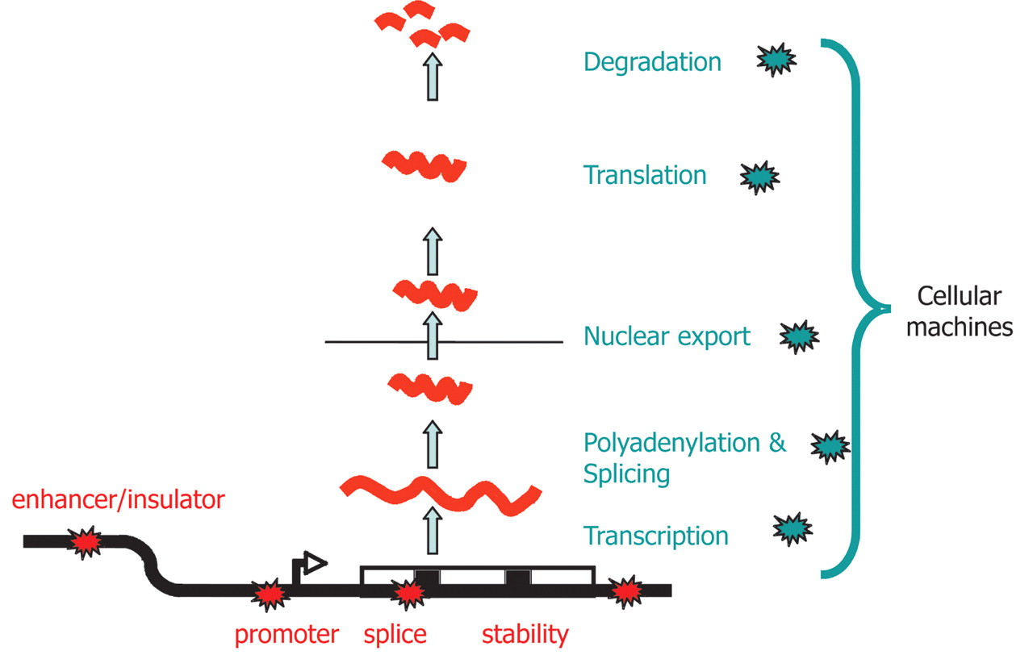
Effects on Gene Expression
Genetic variants influencing gene expression may reside within:
Regulatory sequences
Promoters
Enhancers
Splice sites
Secondary Structure Motifs
Williams et al, 2007, Genome Research 17:1707-1716

Slide 13
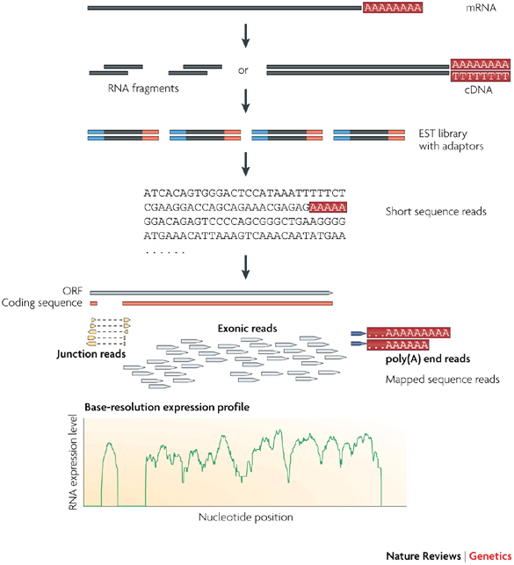
Measuring Gene Expression
RNA-Seq is a common, modern procedure for measuring gene expression. The number of sequence reads that align to a gene is called a tag or read count
These counts are typically normalized across samples in terms of reads/fragments per kilobase million reads (R/FPKM):
Alternative normalization can use transcripts per million (TPM):
(covered in last session!)
Wang et al, 2009, Nat Rev Genet, 10:57-63

Slide 14
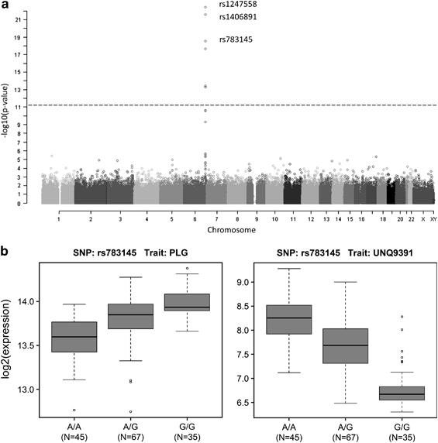
Linking Genotypes with Gene Expression
An expression quantitative trait locus (eQTL) is a position in the genome that explains a fraction of the variance associated with gene expression.
Standard eQTL analysis involves the direct pairwise testing between genetic markers (e.g. SNPs) and gene expression levels across many (>100) individuals.
This can be done proximal (cis) or distal (trans) to each gene.
Association of SNPs with PLG (cis) and UNQ9391 (trans) expression in the context of drug absorption, distribution, metabolism and excretion in the liver.
Schröder et al, 2011, Pharmacogenomics, 13:12-20

Slide 15
Testing for eQTL Associations
Typical approaches make use of Generalized Linear Models (GLMs).
For simplicity, we will consider simple linear models of the form:
where Y_{i} is the normalized gene expression (FPKM) for individual i and X_{i} indicates the genotype (0,1,2) at a given SNP. ε_{i} can be set as a randomly distributed random variable

Slide 16
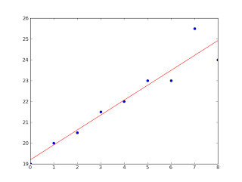
Testing for Associations (Python)
We can use functions available in numpy and scipy to construct our linear model
from numpy import arange,array,ones#,random,linalg
from pylab import plot,show
from scipy import stats
xi = arange(0,9)
# linearly generated sequence
y = [19, 20, 20.5, 21.5, 22, 23, 23, 25.5, 24]
slope, intercept, r_value, p_value, std_err = stats.linregress(xi,y)
print 'r value', r_value
print 'p_value', p_value
print 'standard deviation', std_err
line = slope*xi+intercept
plot(xi,line,'r-',xi,y,'o')
show()
http://glowingpython.blogspot.com/2012/03/linear-regression-with-numpy.html

Slide 17
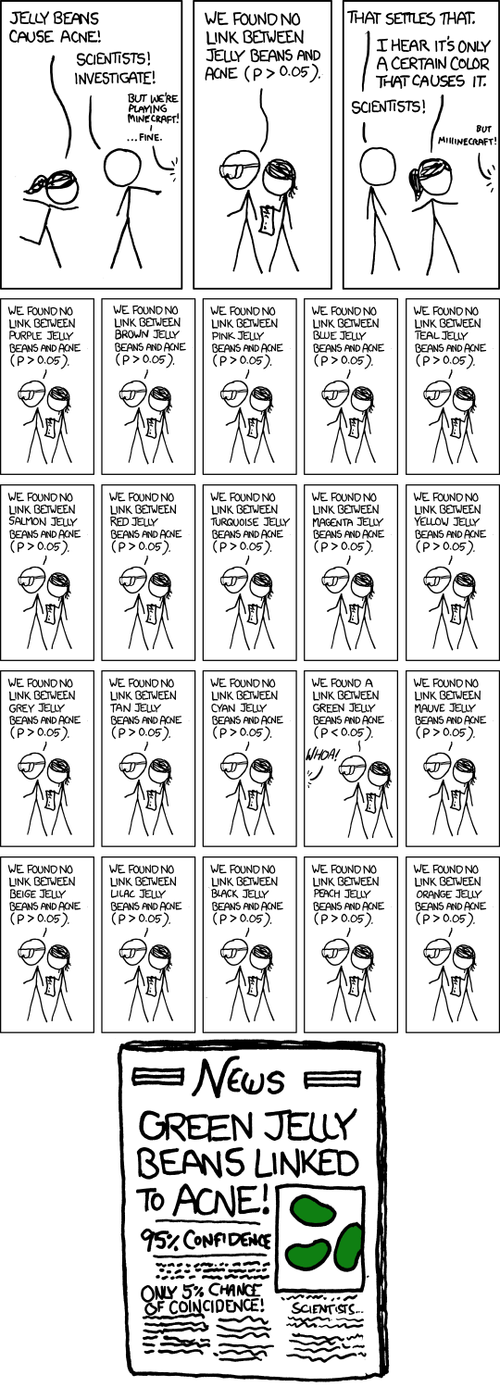
Multiple Test Correction
Different methods available for correcting p-values for multiple tests.
Bonferroni corrections weight the p-values by the number of tests done
with a as the significance level (0.05) and m is the number of tests conducted. This controls the Familywise error rate
Other correction methods are also useful, for example Benjamani-Hochberg which can be used to control the false discovery rate
https://xkcd.com/882/

Slide 18
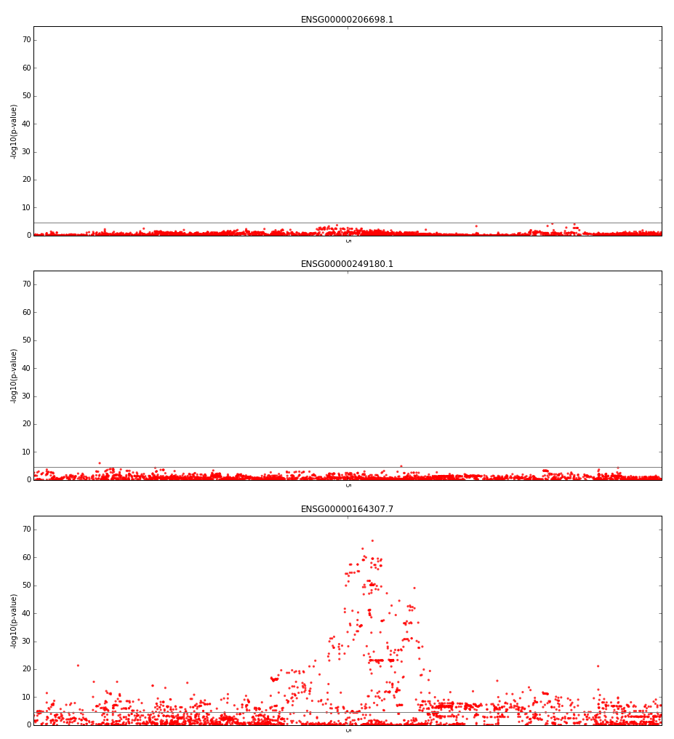
Visualizing Results
Association results for each SNP can be visualized by plotting their corrected p-values at each SNP position across a chromosome.
These types of plots are called ‘Manhattan’ plots due to their (somewhat) resemblance to a city skyline.
For ease of viewing, p-values are typically converted by multiplying them by –log₁₀(p-value)

Slide 19
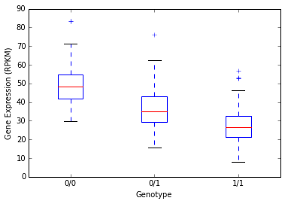
Visualizing Results
Highly significant associations can be further examined using categorical boxplots of the genotypes and their associated gene expression levels.

